Slide 1
Smart guest identifier with remote access management
By Bhargava
Pavan
Parthu

Slide 2

Problem Statement: To design a system to identify and recognize a person/guest and Provide access based on owner’s Approval or permission setting

Slide 3
Components
Hardware Components
Laptop
Logitech webcam
Raspberrypi3
Ethernet cable
Software Components
Python 2.7
VNC viewer
OpenCV2
IBM cloud platform*
*indicates optional

Slide 4
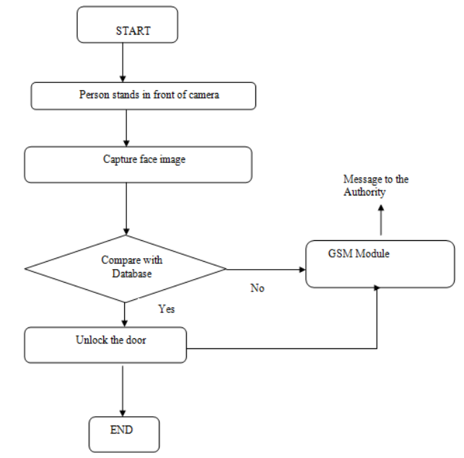
How it works?

Slide 5
ADVANTAGES
It is low cost system which can be made under 5000 INR.
Using this system, the home can be monitored and controlled remotely
The system can work on both modes online and offline mode.

Slide 6
Conclusion
Remote controlling and monitoring is possible because of using IoT and Face recognition has made it almost extremely difficult to hack.

Slide 7
Thank you

